Slide 1
Theories and Principles of Learning
“ Success is the sum of small efforts, repeated day in and day out”
Robert Collier

Slide 2
Value of Theory
Theory is a way to explain some observed phenomenon
Expressed as abstract thoughts or general subjects principles, theories help make sense of the world and research findings (The Merriam Webster Dictionary, 2016).
A theory provides reasoning for why something may occur or explain patterns in behaviour
"an attempt to explain something".
A theory is an idea you construct to explain a phenomenon, having taken into account all known variables and experiences. This is something that forms over time and can change as you learn.

Slide 3
Reason For Theories
You need a theory when you:
Confront a new situation and what you already
know does not apply to that situation
You want to increase your understanding of
something relatively familiar
You face a familiar situation, but what you already know does not work
Wish to teach what you know to a colleague or client
Question the validity of a cherished belief
Explore new hypothesis (premise, proposition)

Slide 4
Theories of Learning
Learning: A dynamic , lifelong process that is unique to each individual
Learning occurs when: There is a change occurs in the learner’s behavior, attitudes, or skills
Learning theories provide the theoretical framework to understand how people learn:
How to acquire new knowledge
Develop skills
Modify attitudes and values and:
- Learn new behaviors

Slide 5
Theories of Learning Cont.
Learning theories fall into two camps:
Behaviorism and cognitivism
Behaviorism focus on tangible, observables behaviors, i.e. learning to give an injection, changing dietary practices & safely bathing an infant.
Cognitivism focus on the thought processes as human learn i.e. seeing a relationship between food intake and blood glucose levels, using memory tricks to recall health instructions & gaining insight into one’s own behavior

Slide 6
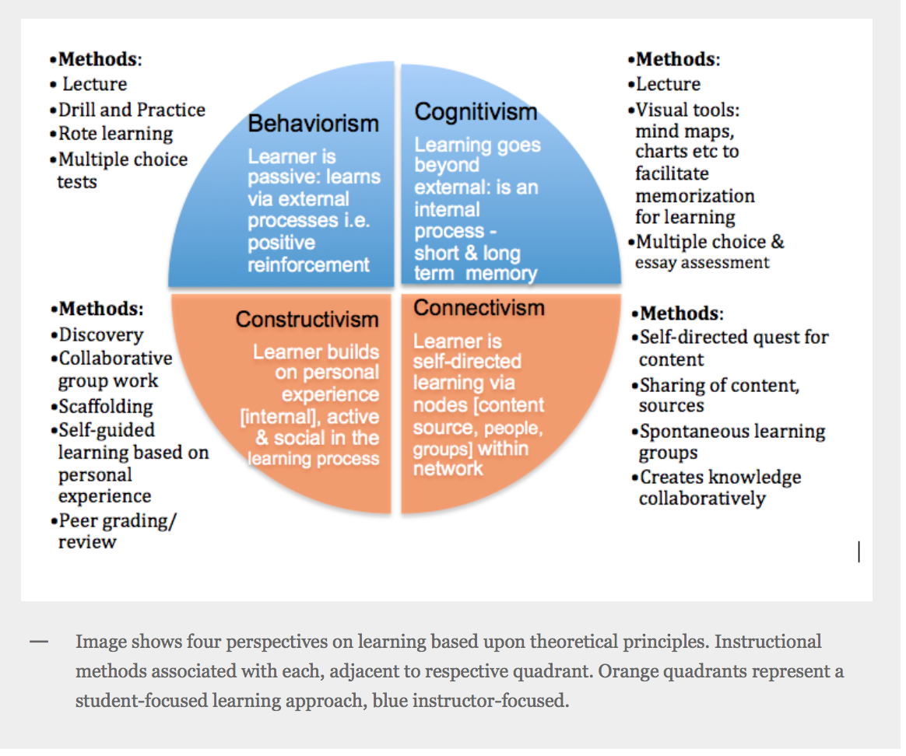
Theories of Learning

Slide 7
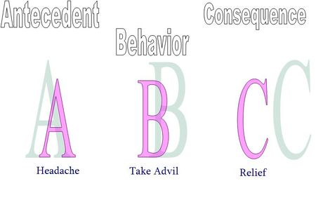
Implications For Health Education
Behavior modification is the application of learning theory to modify behavior i.e.:
Stimulus-Behavior-Consequences:

Slide 8
Implications For Health Education Cont.
Cognitive view of learning:
Cognitivism (cognitive psychology) is a predominant theoretical perspective for studying human learning today.
Its focus is in the cognitive processes: “How people perceive, interpret, remember” (Ormrod, 2012).
Cognitivism expands the understanding of learning
To include internal mental processes unique to each person such as:
Perception, insight, and meaning

Slide 9
Cognitive Views of Learning
It includes several perspectives:
Gestalt psychology & information processing
theory
Gestalt, a German word meaning: “the
configuration or pattern” (Olson & Hergenhahn,2013, p. 240),
the whole or totality:
It means that the whole is more than merely the sum of its parts

Slide 10

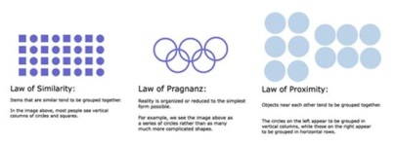
Gestalt is a psychology term which means "unified whole". It refers to theories of visual perception developed by German psychologists in the 1920s. These theories attempt to describe how people tend to organize visual elements into groups or unified wholes when certain principles are applied. These principles are:
Similarity occurs when objects look similar to one another. People often perceive them as a group or pattern. When similarity occurs, an object can be emphasized if it is dissimilar to the others. This is called anomally.

Slide 11
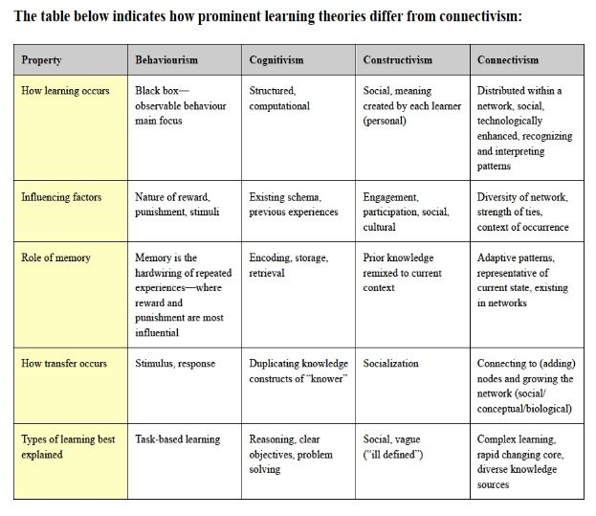
Comparison of Theories

Slide 12
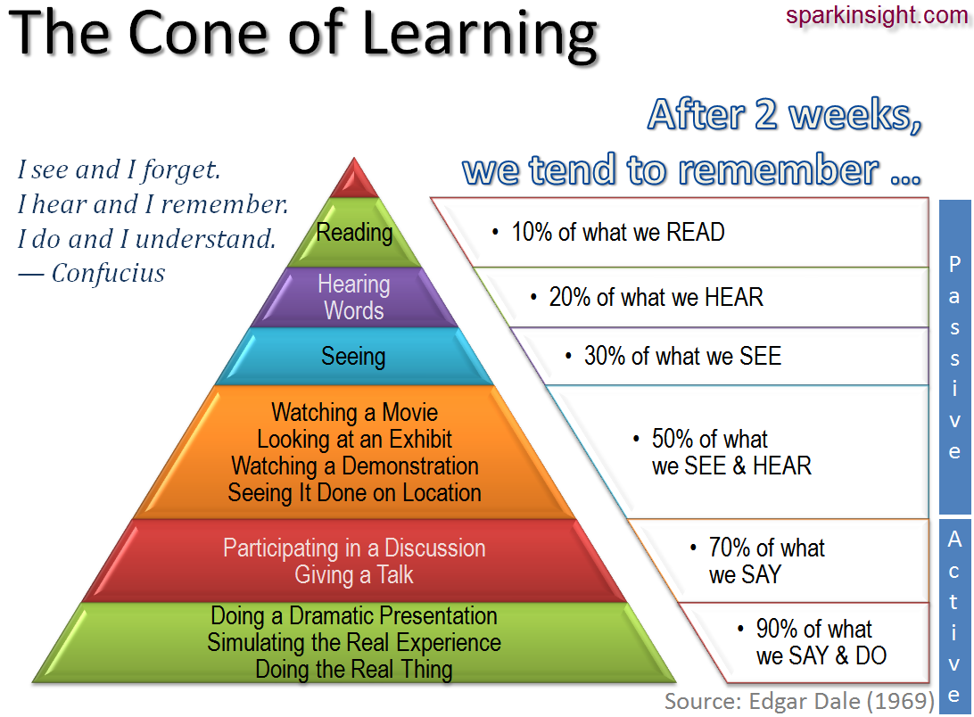
Theories Of Learning Cont.

Slide 13
Social Cognitive View of Learning
Bandura’s (1960 & 1970) theory is an outgrowth of the behavioral theories of learning, that he believed lacked a complete explanation for learning
His theory supports principles that support social cognitive view of learning:
People learn through a process of modeling & observing other’s behavior
People learn vicariously from other’s successes & failures
Learning may or may not result in an observable change of behavior

Slide 14
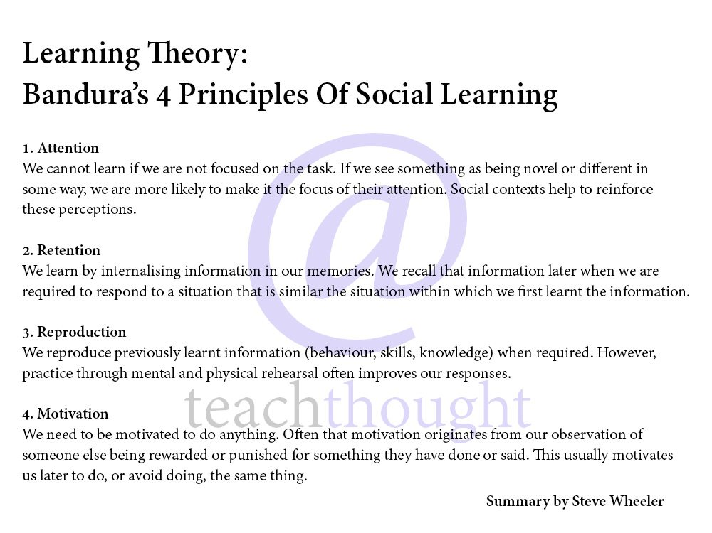

Slide 15
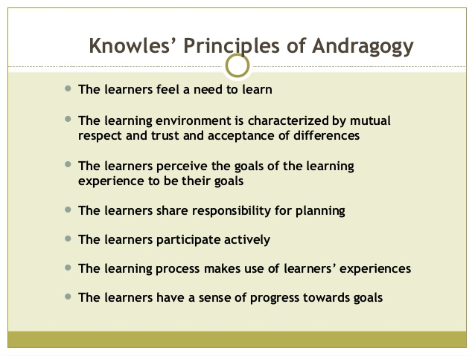
The Adult Learner

Slide 16
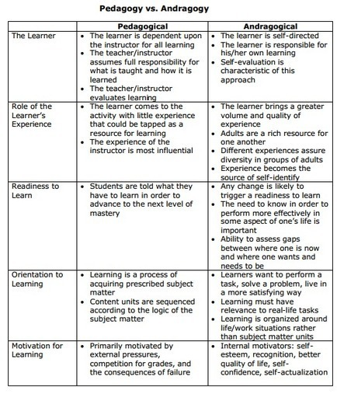
Pedagogy VS Andragogy

